Slide 1
ROVer Optometry: Underwater Object Detection

Slide 2
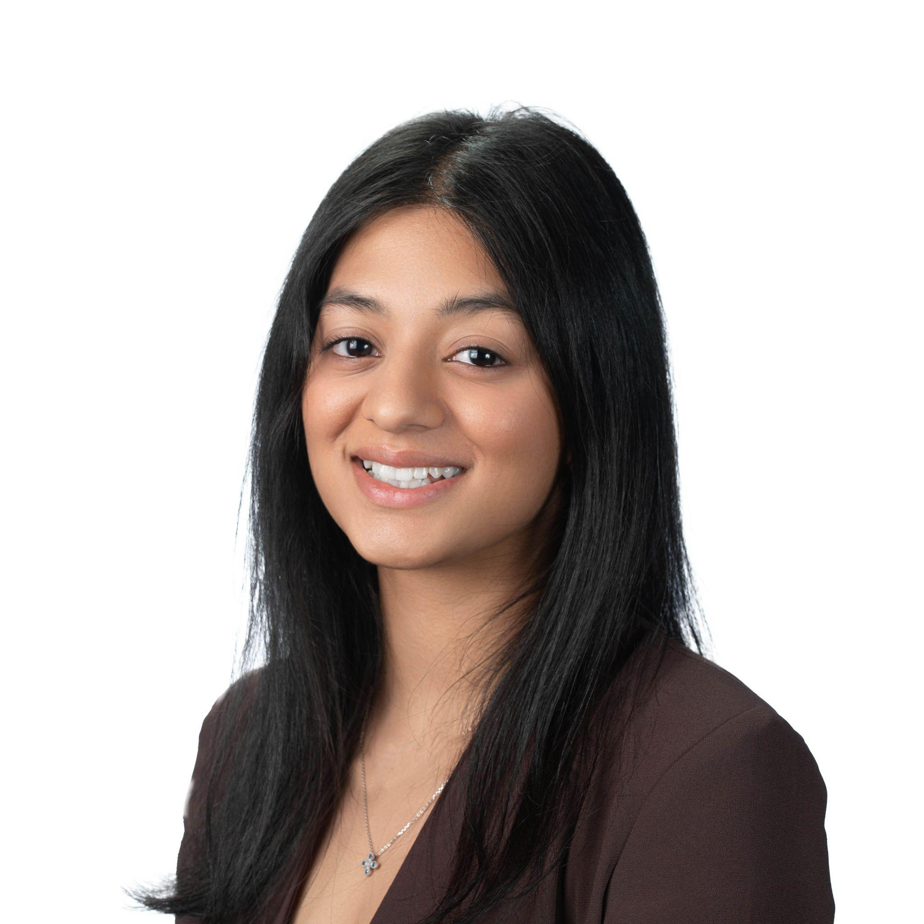
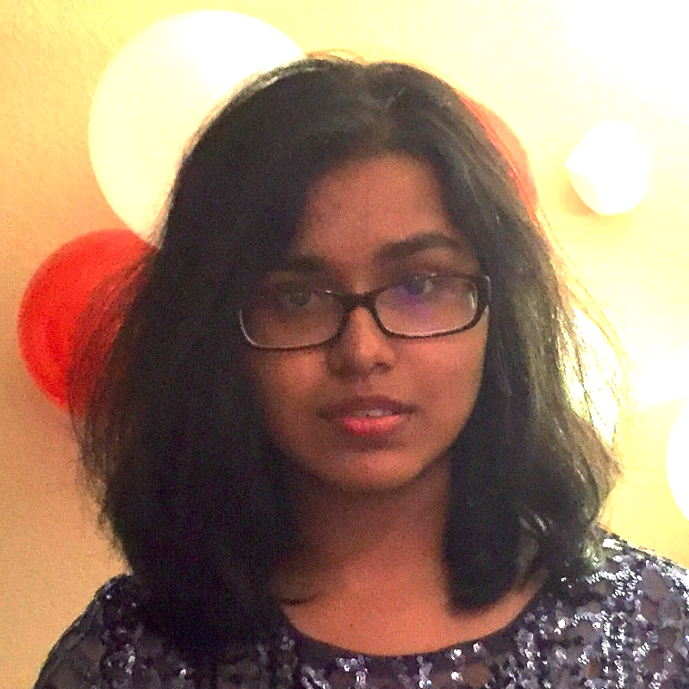
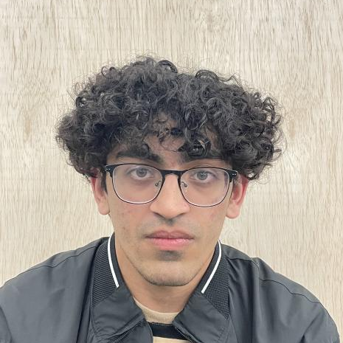
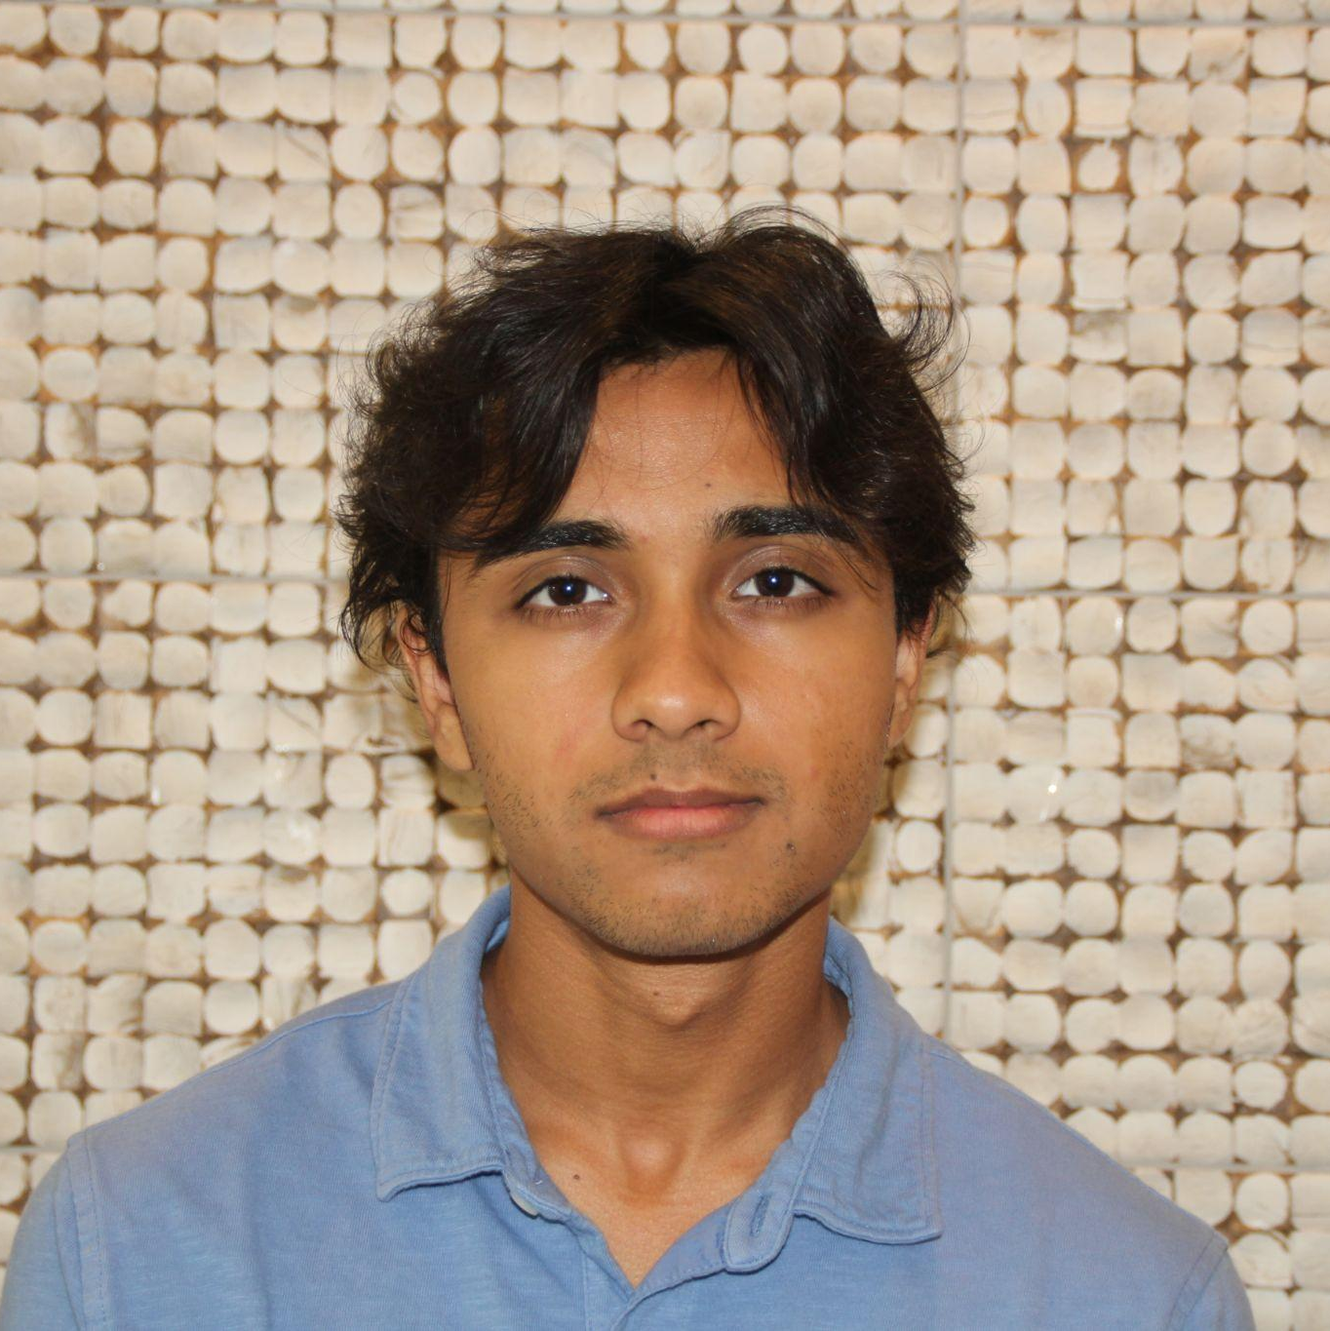
Our Team
Sruti Karthikeyan
Parisa Nawar
Farman Ali
Aditya Kulkarni

Slide 3

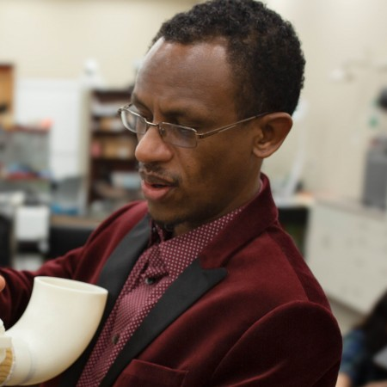
Our Leadership
Team Lead:
Aarian Ahsan
Faculty Advisor:
Dr. Yonas Tadesse

Slide 4
Introduction
1

Slide 5
Objective: To achieve high-accuracy underwater image classification.
Methodology: Utilization of low-light analog camera to capture images of underwater debris which is then detected as trash using a trained CNN model.
Notes:
Methodology: Use of low light analog camera inside waterproof container to capture images of underwater debris, which is then processed using a CNN model trained to detect trash in a marine-like environment.
Low-light analog camera captures underwater debris. CNN detects marine trash.
Utilization of low-light analog camera to capture images of underwater debris which is then detected as trash using a trained CNN model.

Slide 6
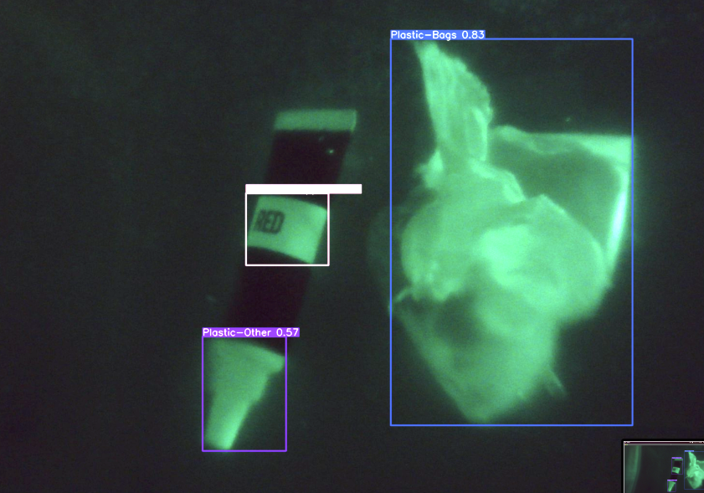
YOLOv7 provides:
Real-time object detection
Low-inference times
Notes:
YOLOv7 is a version of the YOLO (You Only Look Once) architecture designed for object detection.
Provides: real-time object detection and low-inference times, essential for efficient and timely detection of moving objects in the constantly changing underwater environment.

Slide 7
Dataset
2

Slide 8
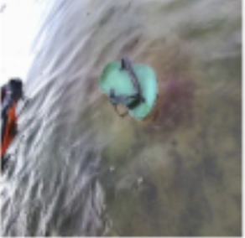
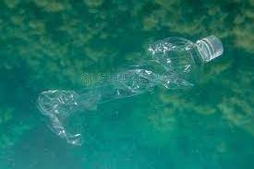
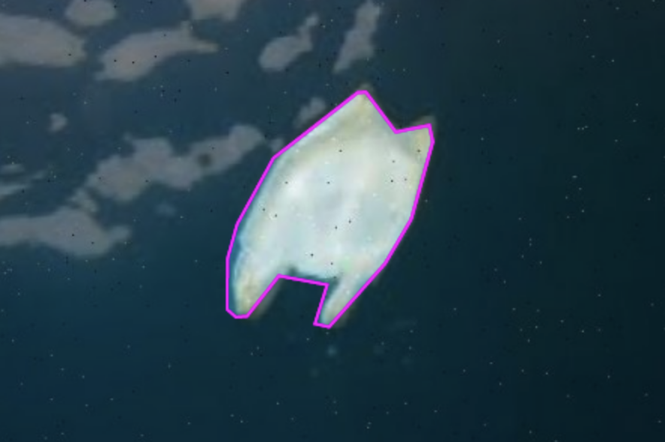
We compiled an underwater dataset from Roboflow with over 13,000 images of underwater trash such as plastic wrappers and water bottles in order to train our model.
Examples of images in dataset
Notes:
basura Dataset > Overview (roboflow.com)

Slide 9
Training
3

Slide 10
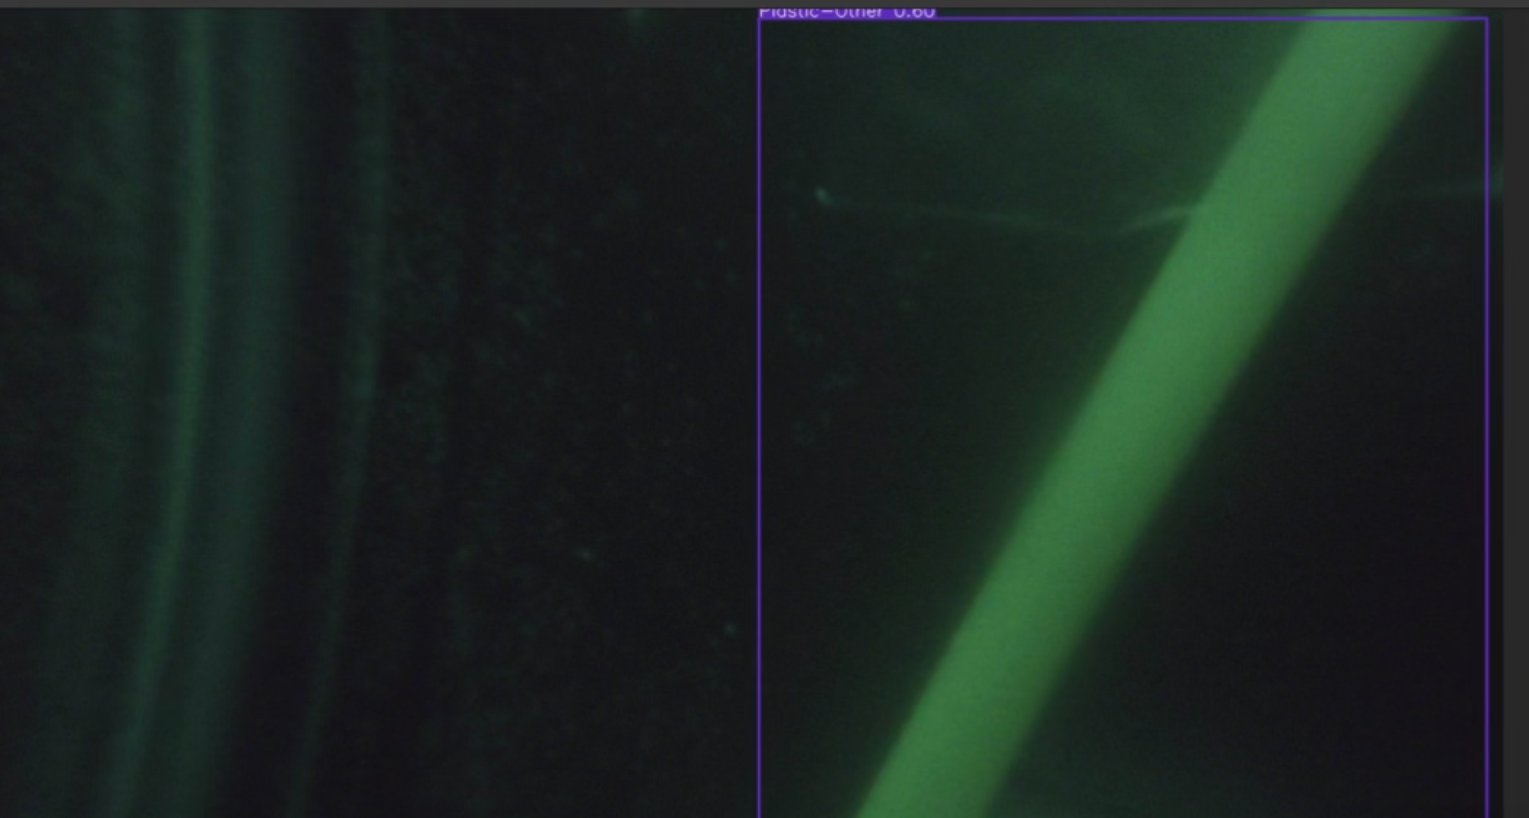
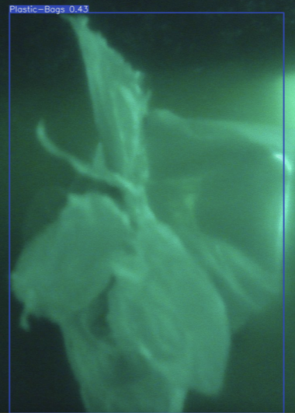
Configured a custom Linux machine through remote access.
Trained 200 epochs with a batch-size of 4.
Acquired proper weights and bias’.
Notes:
Utilizing a custom Linux machine, we trained 200 epochs with a batch-size of 4 in order to provide the proper weights and bias' for the resulting detection mechanism.

Slide 11
Results
4

Slide 12
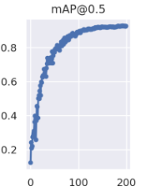
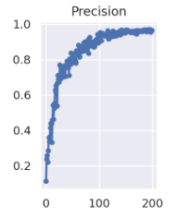
Mean Average Precision:
X-axis: Epoch
count
Y-axis: mean average precision of IoU 0.5:0.95
Precision Curve:
X-axis: Epoch
count
Y-axis: accurate predicted positives
Notes:
The model gave us a validation precision score at 96.05 and a recall score of 90.85. With mAP scores of 88.5 at an IOU of 0.5 and 79.32 at an IOU of 0.95, relatively accurate data.

Slide 13
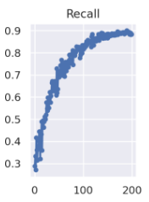
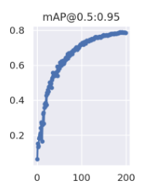
Recall/Sensitivity Curve:
X-axis: Epoch count
Y-axis: Accurate positives
Mean Average Precision:
X-axis: Epoch count
Y-axis: mean average precision of IoU 0.5:0.95

Slide 14
Challenges
5

Slide 15




Datasets
Types of Trash
Quality of Dataset
Image Quality
Low Lighting
Flashlight Phone light
Natural Lighting
CPU/GPU Capacity
Computer CPU/GPU
Virtual Machine
Testing
Simulating a marine environment
Reflections

Slide 16
Conclusion
6
Notes:
Talk about future applications here

Slide 17
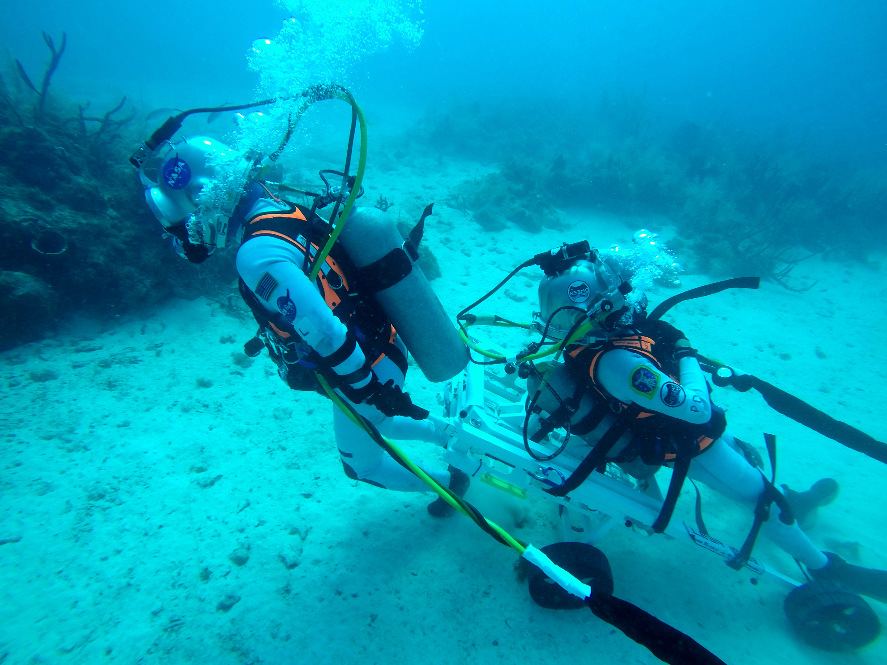
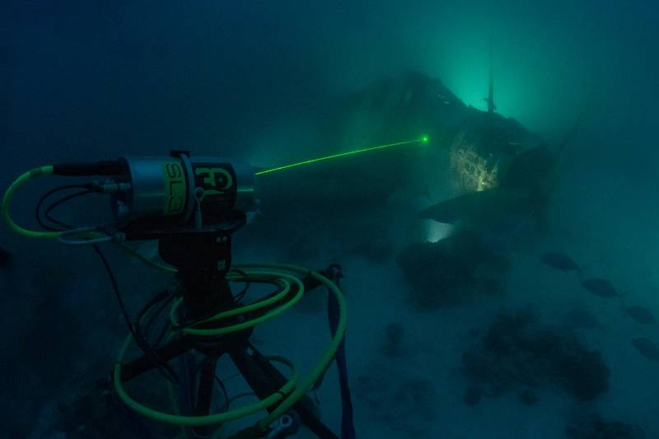
Real World Applications:
Search and Rescue
Nautical Expedition
Future Additions:
Expanded Dataset
beyond Garbage

Slide 18
PROJECT DEMO

Slide 19
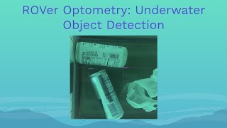

Slide 20
